Slide 1
Diabetes Prediction
Project Demonstration

Slide 2
Student Information
Misbah Ghafoor, Reg # 2024-MS-DS-118

Slide 3
Agenda of Discussion
Problem Statement
Project Methodology
EDA Summary
Concepts Used in the Project
Project Reports (Snippets from the Workbook)
Workbook Overview

Slide 4
Problem Statement
Diabetes is a chronic health condition that affects how the body processes blood sugar (glucose). The problem is to analyze set of features to predict whether a patient is likely to develop diabetes. By identifying patterns and correlations in the data, we aim to create a model that can predict the risk of diabetes, enabling early diagnosis and more effective management of the disease.

Slide 5
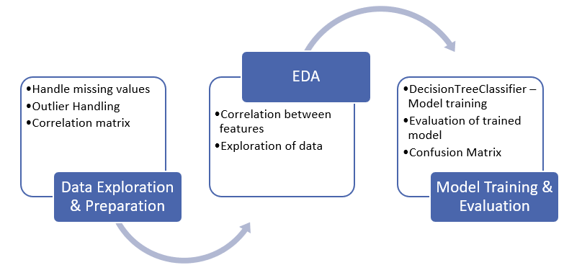
Project Methodology

Slide 6
Task 1 – Data Exploration and Preparation
Data Cleaning: Handle missing values, duplicates, and outliers.

Slide 7
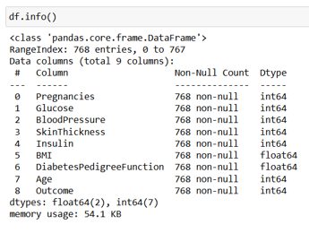
Info()
Info of original dataframe

Slide 8
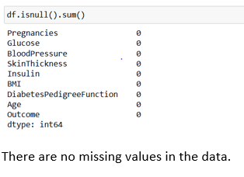
Null Values
No null values

Slide 9
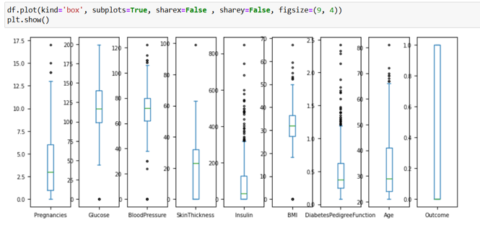
Outlier Handling

Slide 10
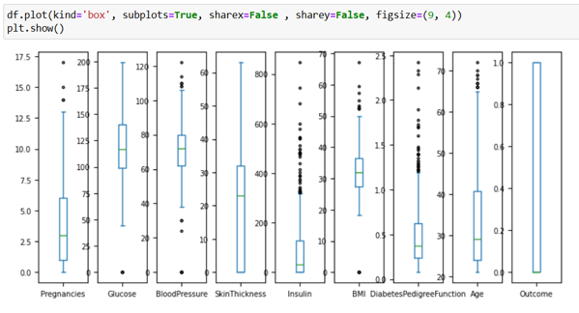
Box Plot after outlier removal

Slide 11
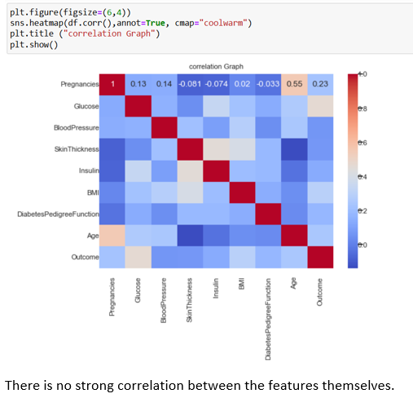
Correlation Between Features

Slide 12
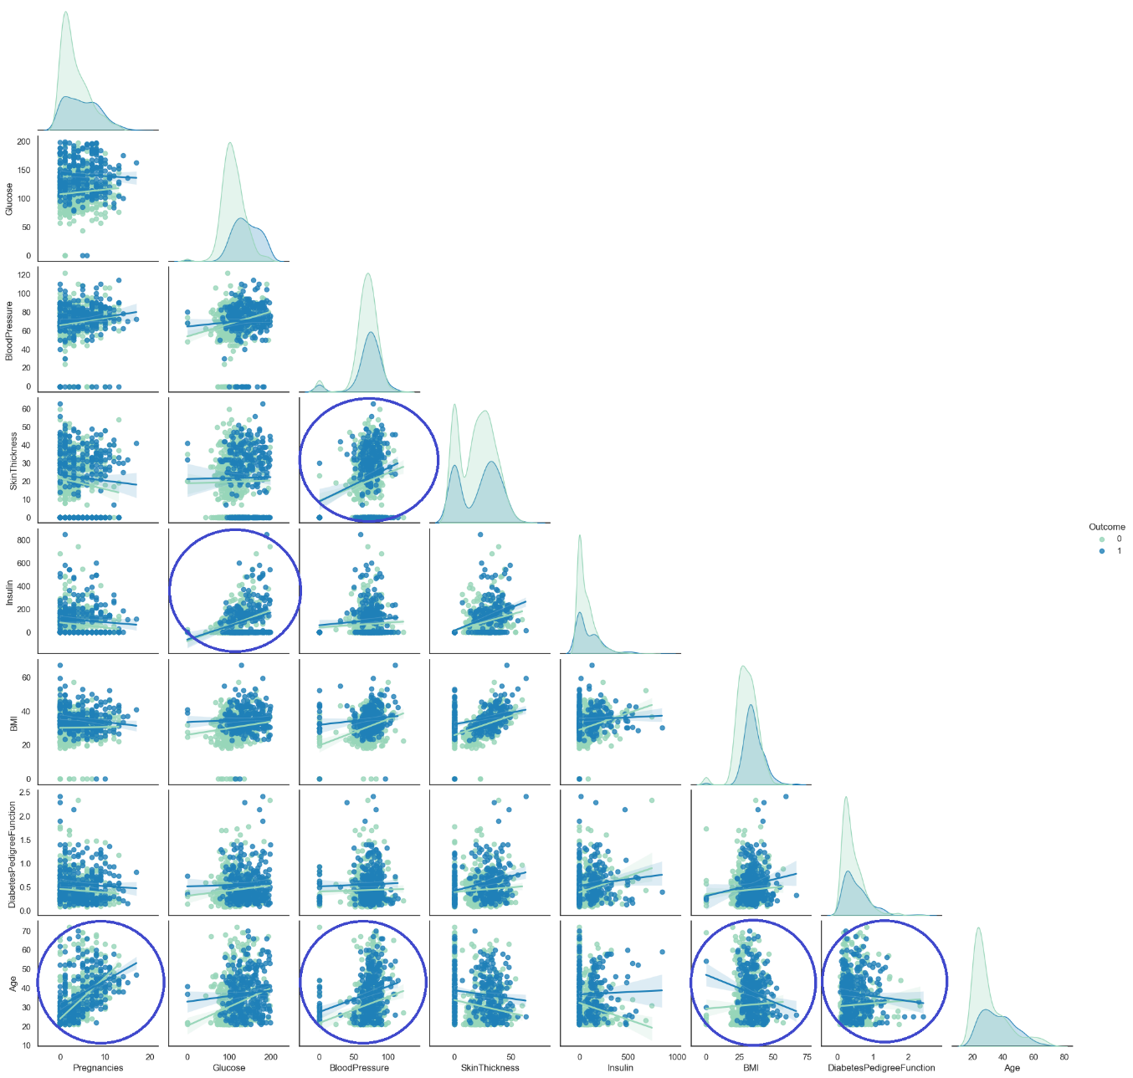
Pair Plot

Slide 13
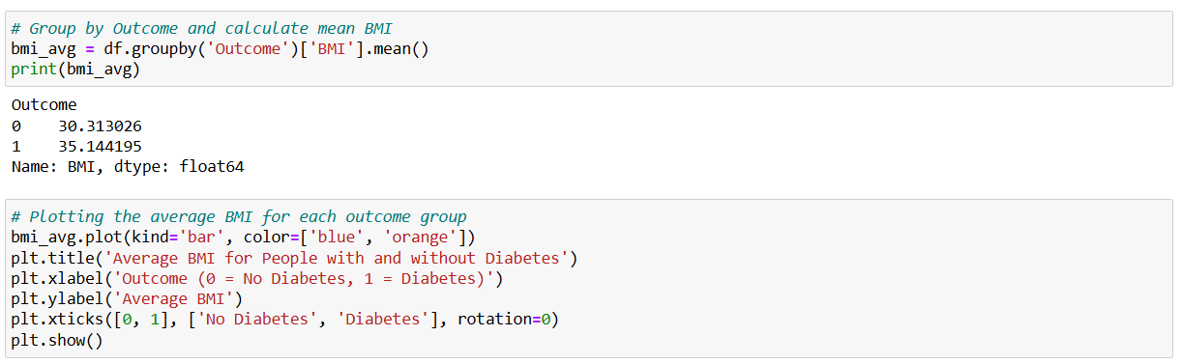
Average BMI for people with and without diabetes

Slide 14
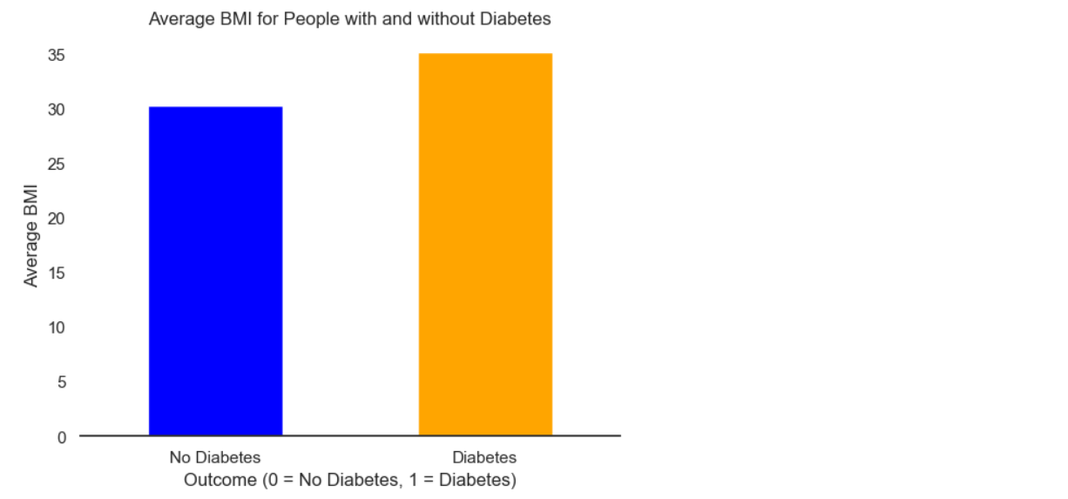
Average BMI for people with and without diabetes (Continued)

Slide 15
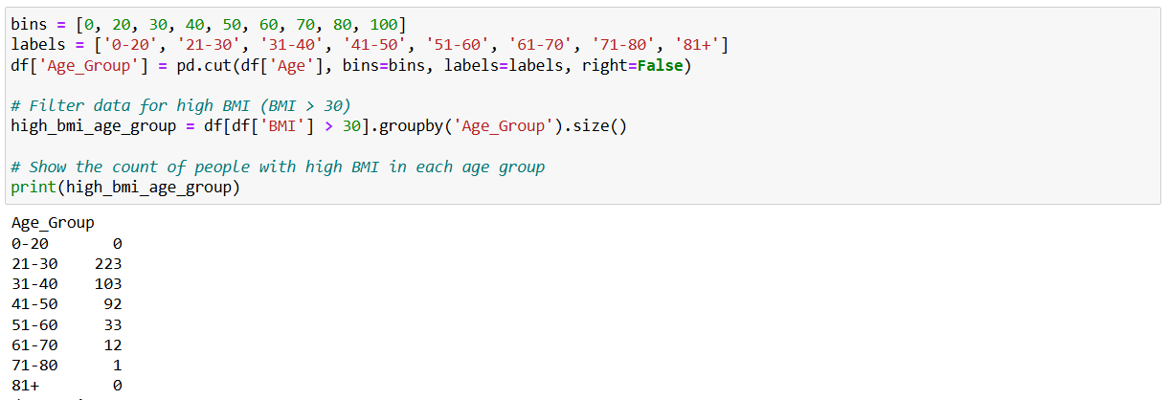
Age group composition

Slide 16
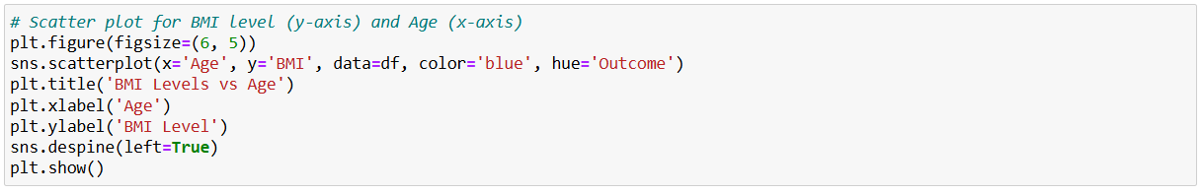
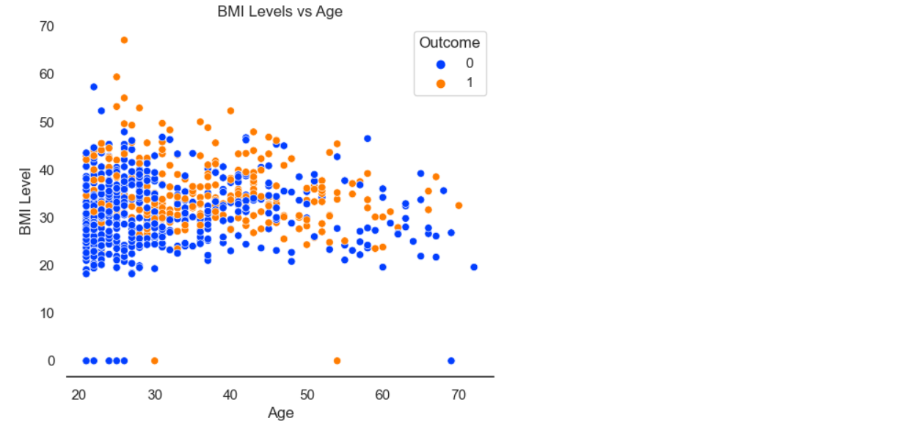
Age vs. BMI Scatter plot

Slide 17
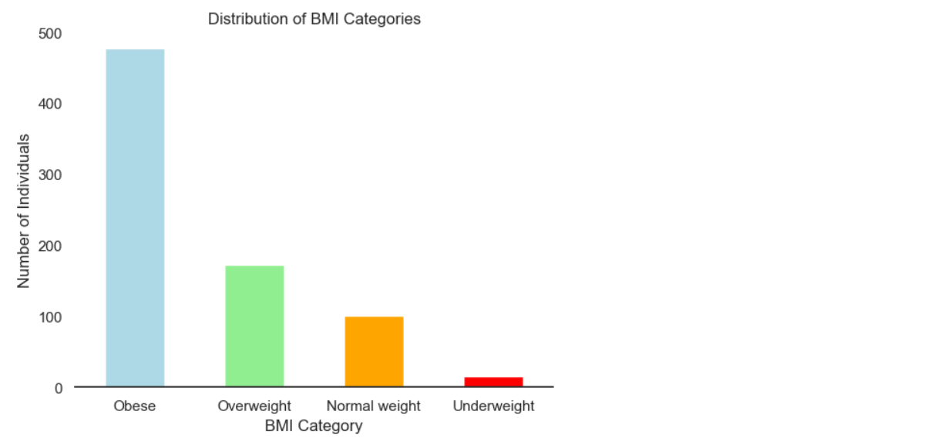
Weight Category vs. BMI

Slide 18
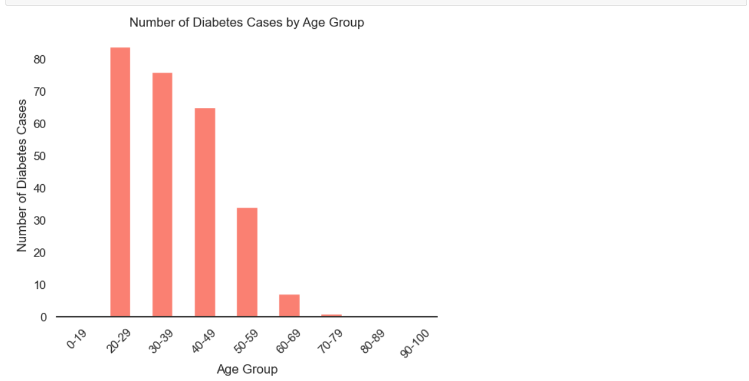
Number of diabetes cases by age Group

Slide 19
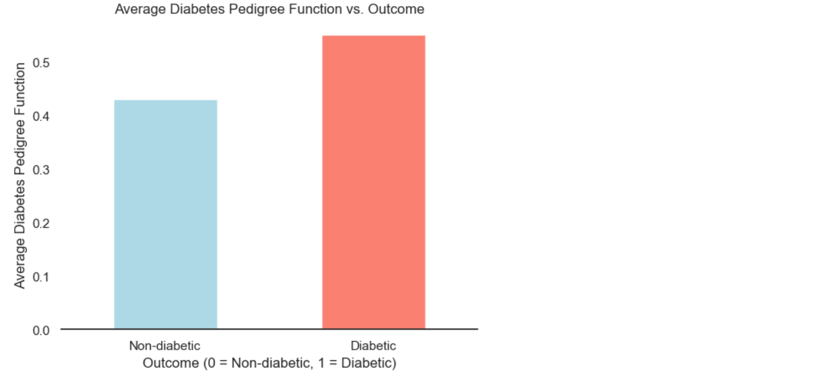
Average Diabetes Pedigree Function

Slide 20
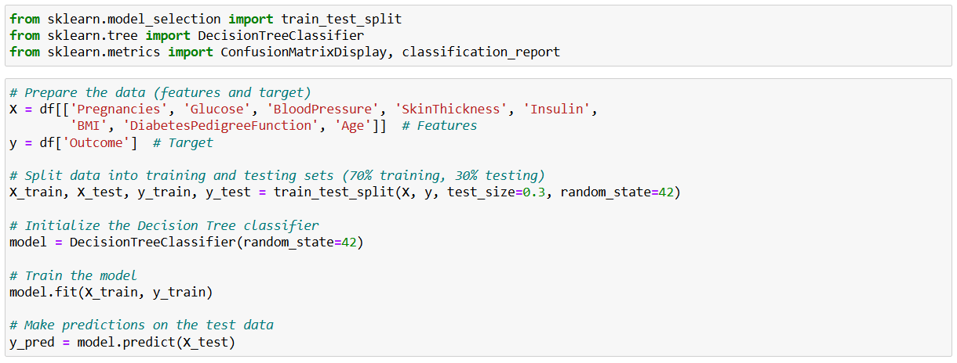
Model Training & Evaluation

Slide 21
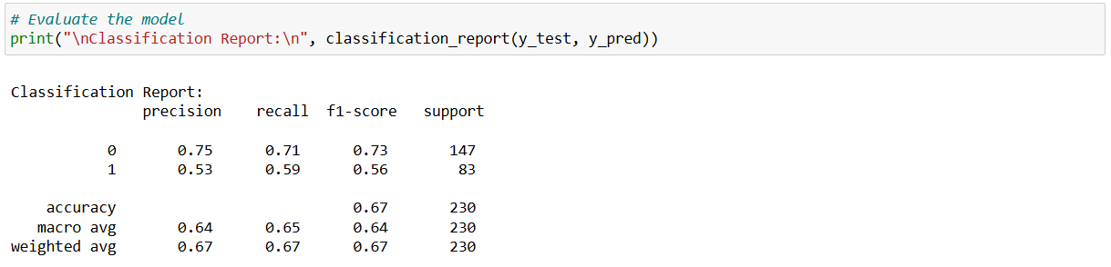
Model Evaluation

Slide 22
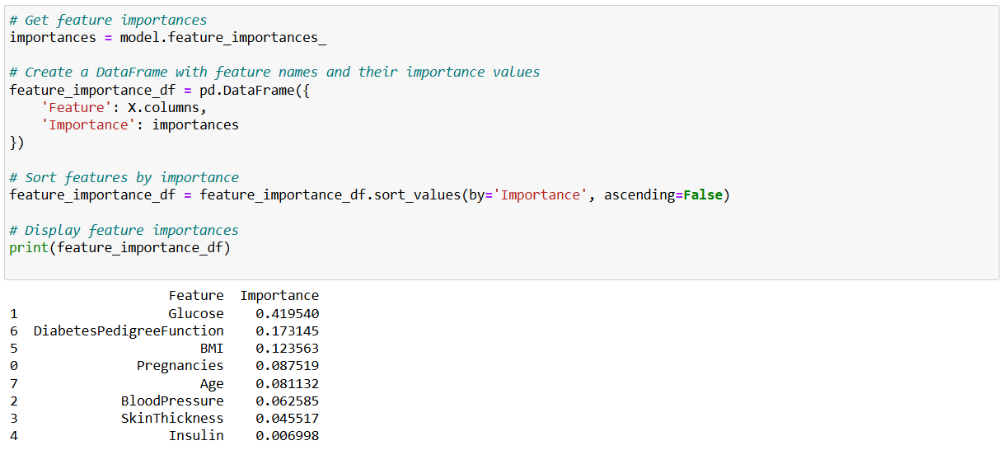
Feature Importance

Slide 23
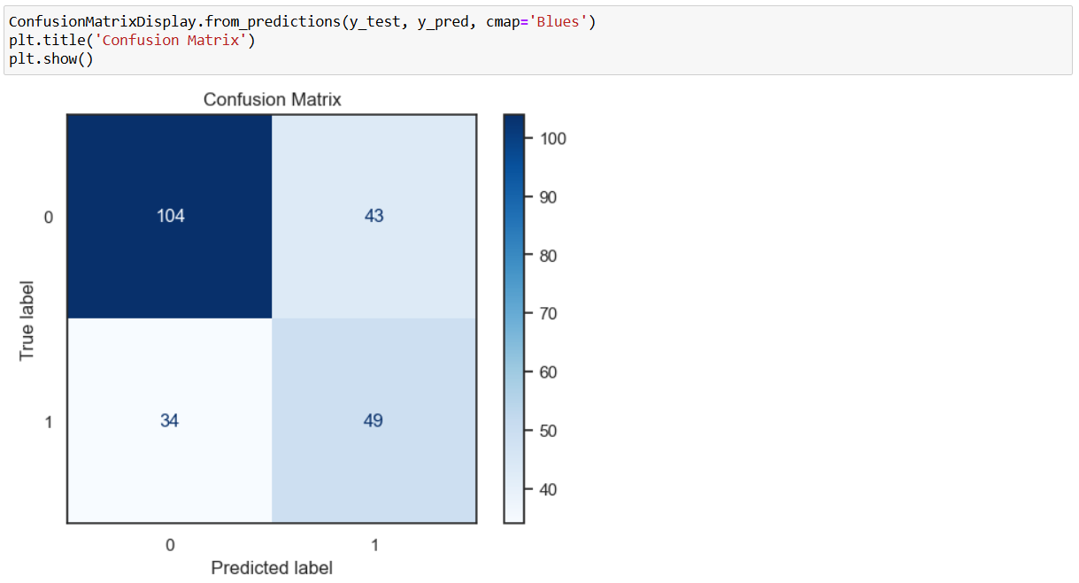
Confusion Matrix

Slide 24
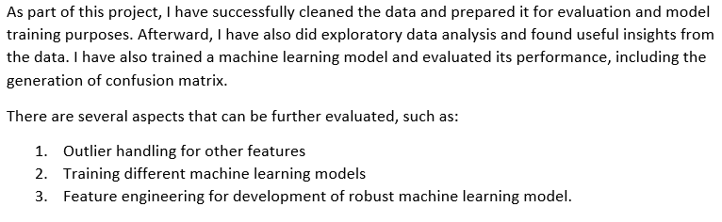
Conclusion & Future Suggestions

